Slide 1
CS5182 Computer Graphics Visual Generative Models
2024/25 Semester A
City University of Hong Kong (DG)

Slide 2
Generative Models
Why do we investigate generative models?
What is generative models?
How do generative models work?

Slide 3
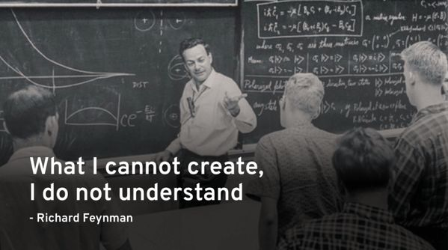
Why investigate generative models?

Slide 4


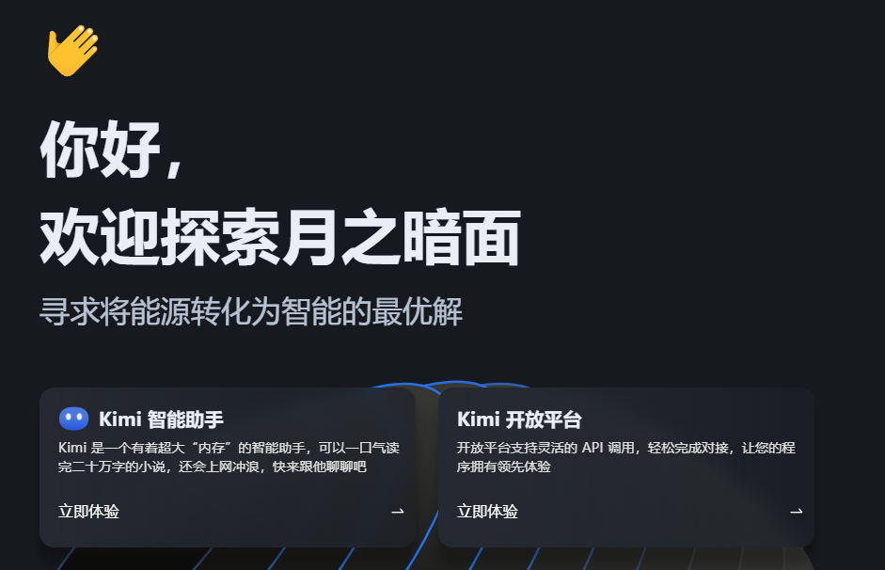
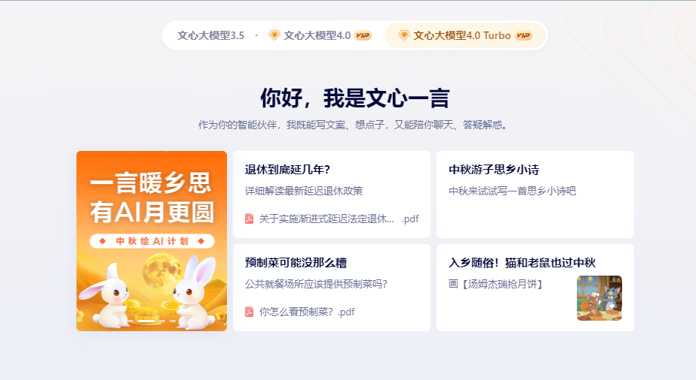
What is generative models?
List some examples of generative models in your life.

Slide 5
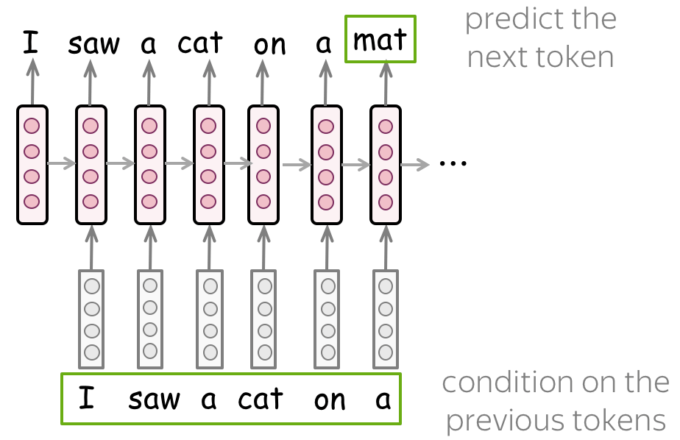
What is generative models?
Text-Generative Model

Slide 6
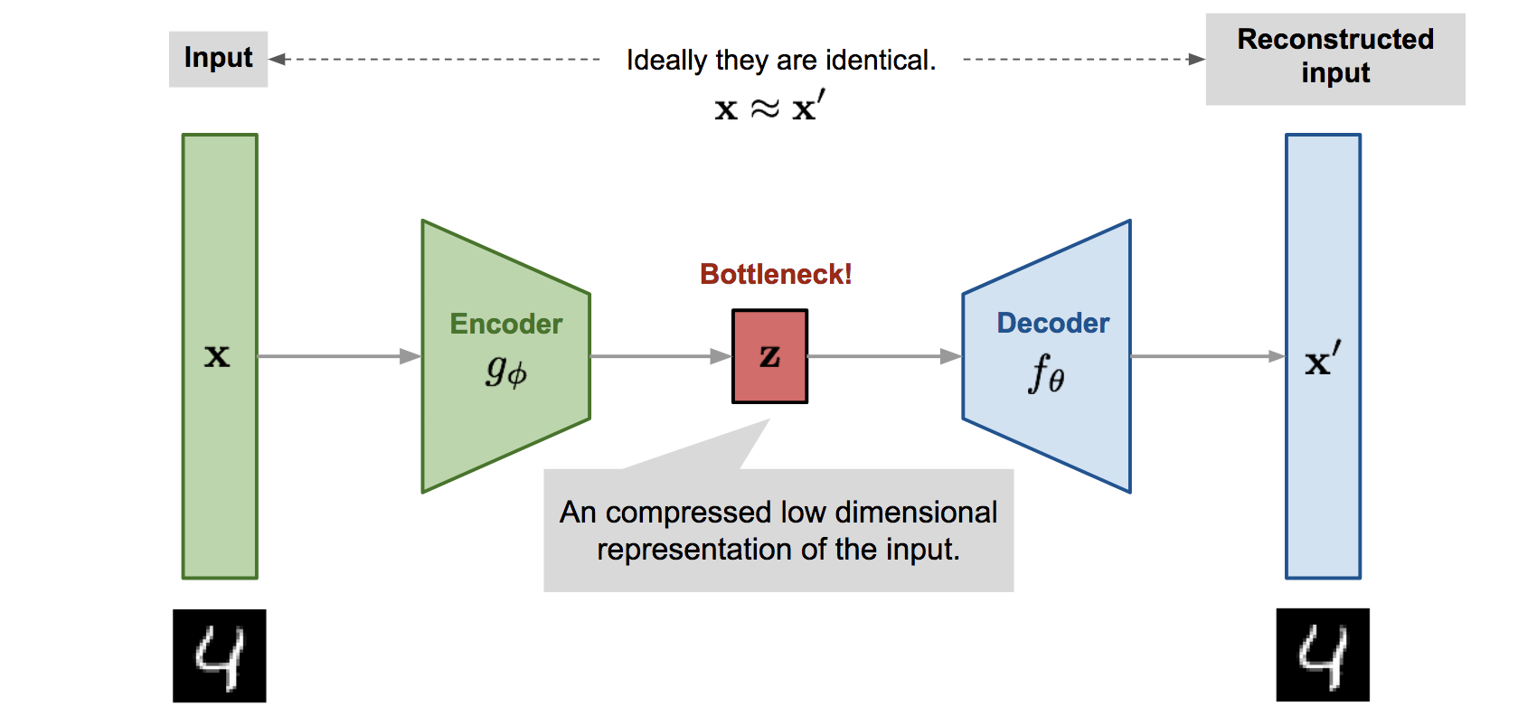
What is generative models?
Visual-Generative Model
(1) variational autoencoder (VAE)

Slide 7
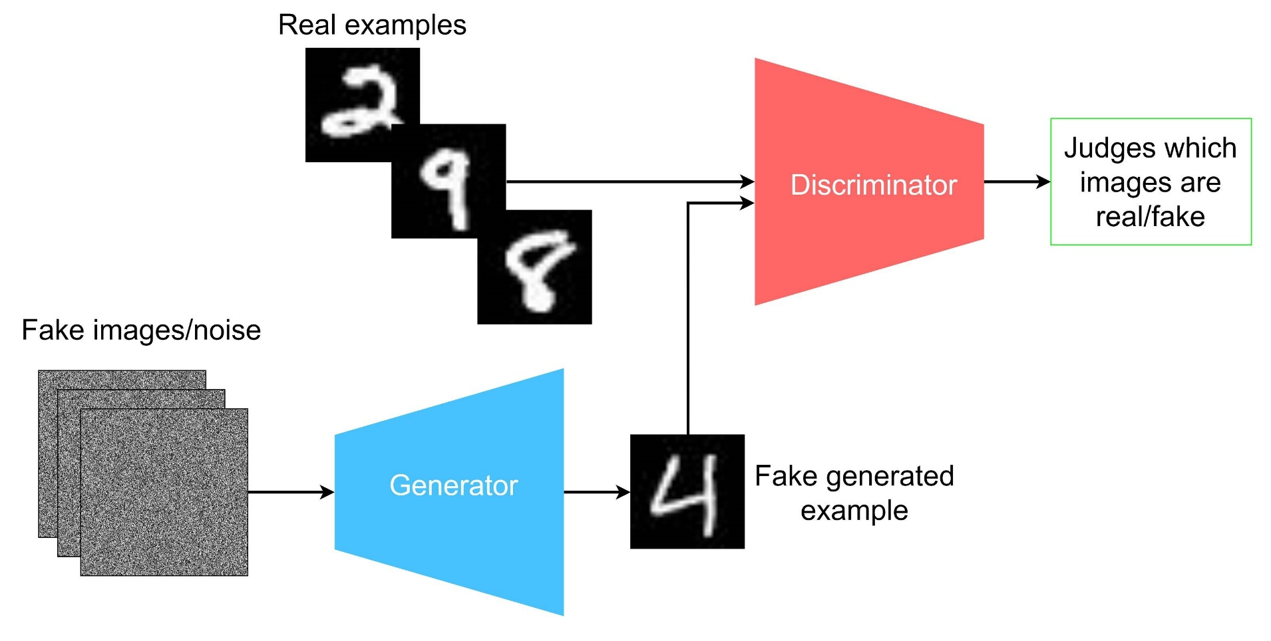
What is generative models?
Visual-Generative Model
(2) Generative adversarial networks (GANs)

Slide 8
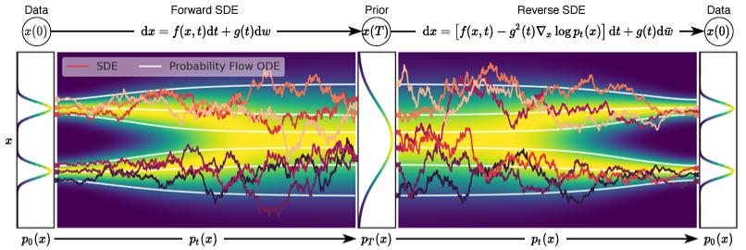
What is generative models?
Visual-Generative Model
(3) Diffusion model

Slide 9
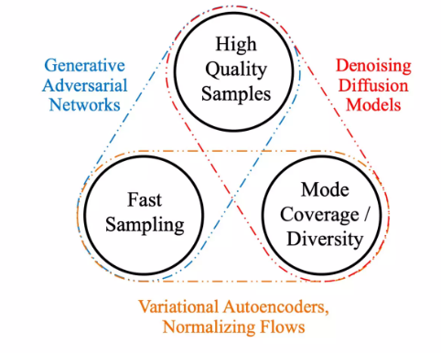
Diffusion Model
Characteristics of Visual-Generative Model

Slide 10
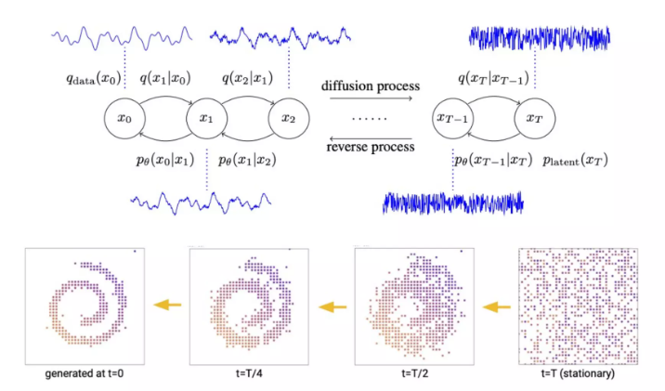
Diffusion Model
Instead of visual signals diffusion model can work on different modalities.

Slide 11


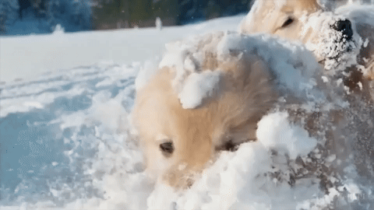
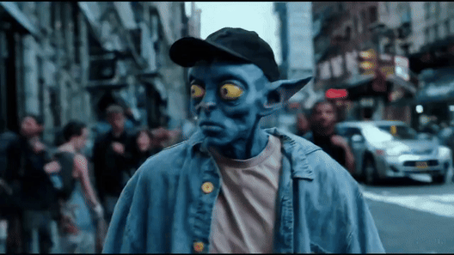
Diffusion Model
Many amazing applications.

Slide 12

Diffusion Model
Many amazing applications.

Slide 13
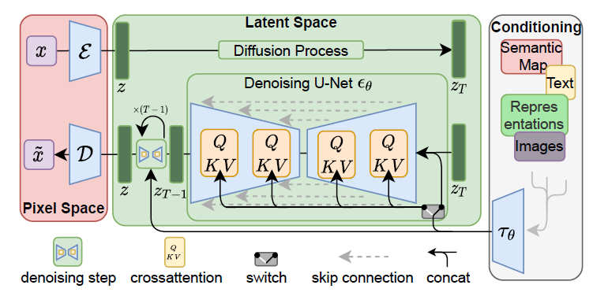
Diffusion Model
Visual-Generative Model
(3) Diffusion model
Conditional Diffusion Model
High-Resolution Image Synthesis with Latent Diffusion Models (CVPR 2022)

Slide 14
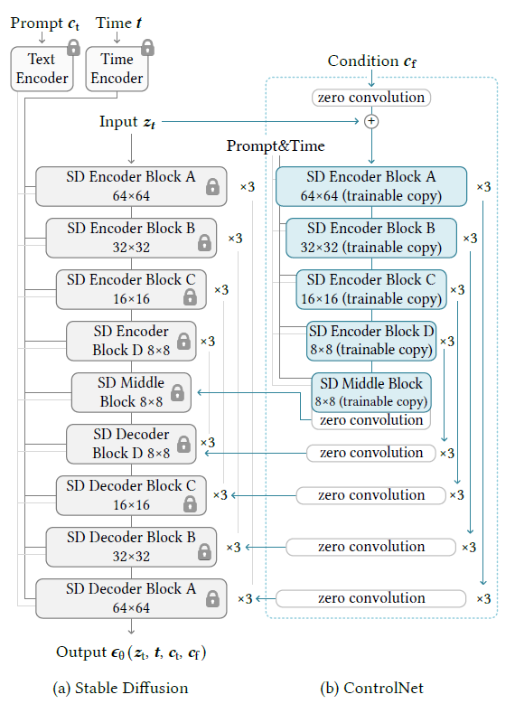
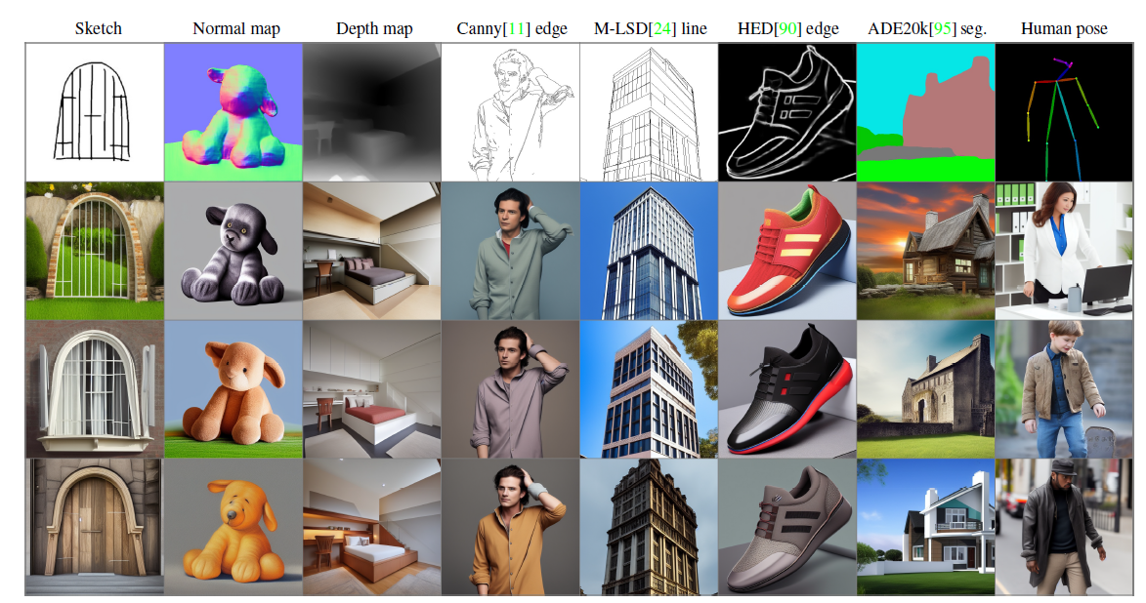
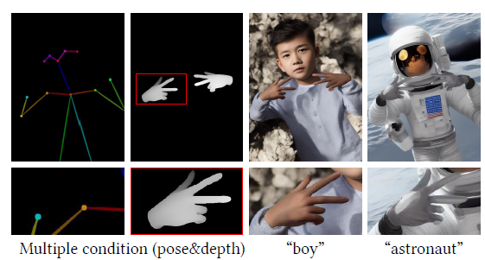
Diffusion Model
Visual-Generative Model
(3) Diffusion model
Conditional Diffusion Model
Adding Conditional Control to Text-to-Image Diffusion Models (ICCV 2023)

Slide 15
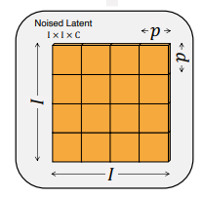
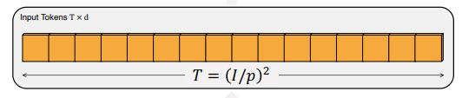
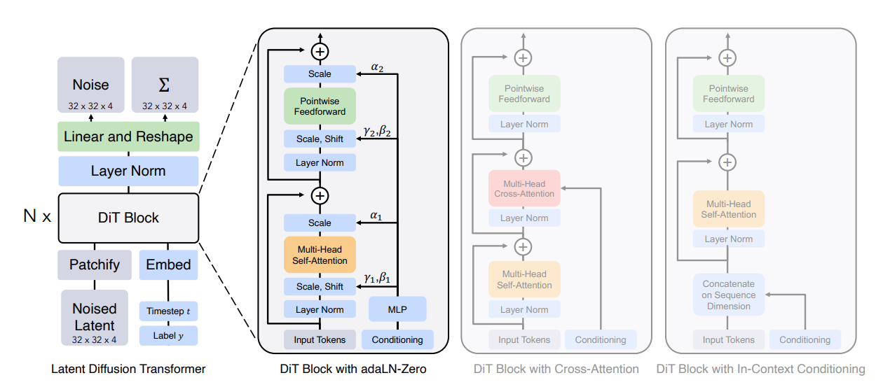
Diffusion Model
Visual-Generative Model
(3) Diffusion model
Patchify:
Diffusion Transformer Model
Scalable Diffusion Models with Transformers (ICCV 2023)

Slide 16
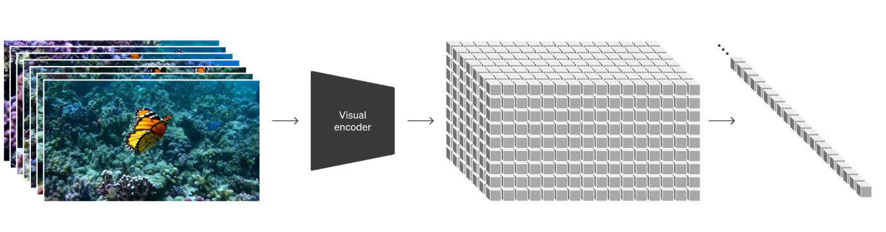
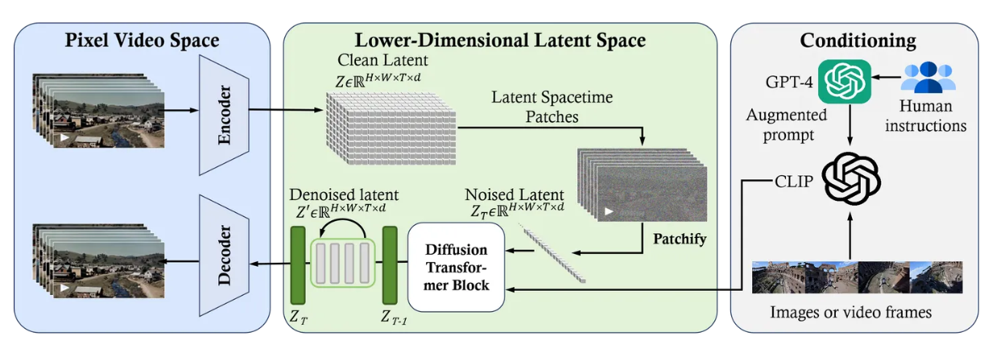
Diffusion Model
Visual-Generative Model
(3) Diffusion model
SORA

Slide 17
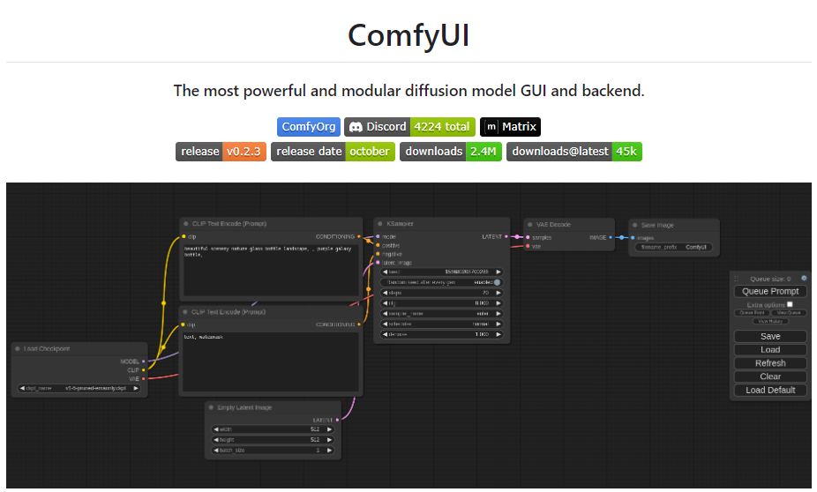
Experiments: ComfyUI

Slide 18
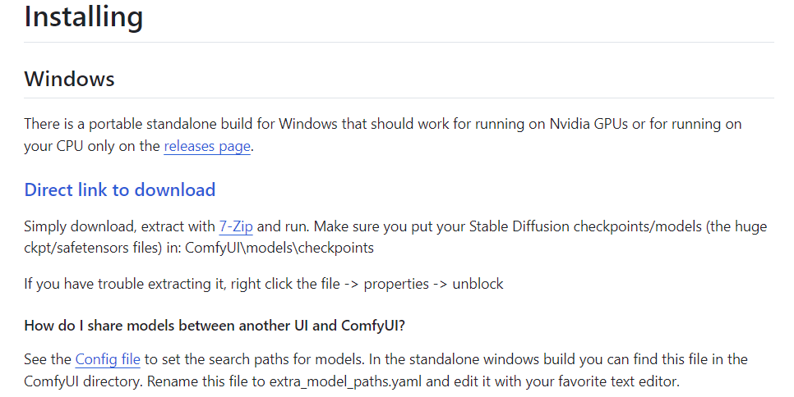
Experiments: ComfyUI
Download ComfyUI
Project Link: https://github.com/comfyanonymous/ComfyUI?tab=readme-ov-file
https://portland-my.sharepoint.com/:f:/g/personal/zhiyuzhu2-c_my_cityu_edu_hk/Ei7IfDnuCTRHnDY9HmMYgC8BcStn7VeR77rYZusddLnlXA?e=QjBUc5
18

Slide 19
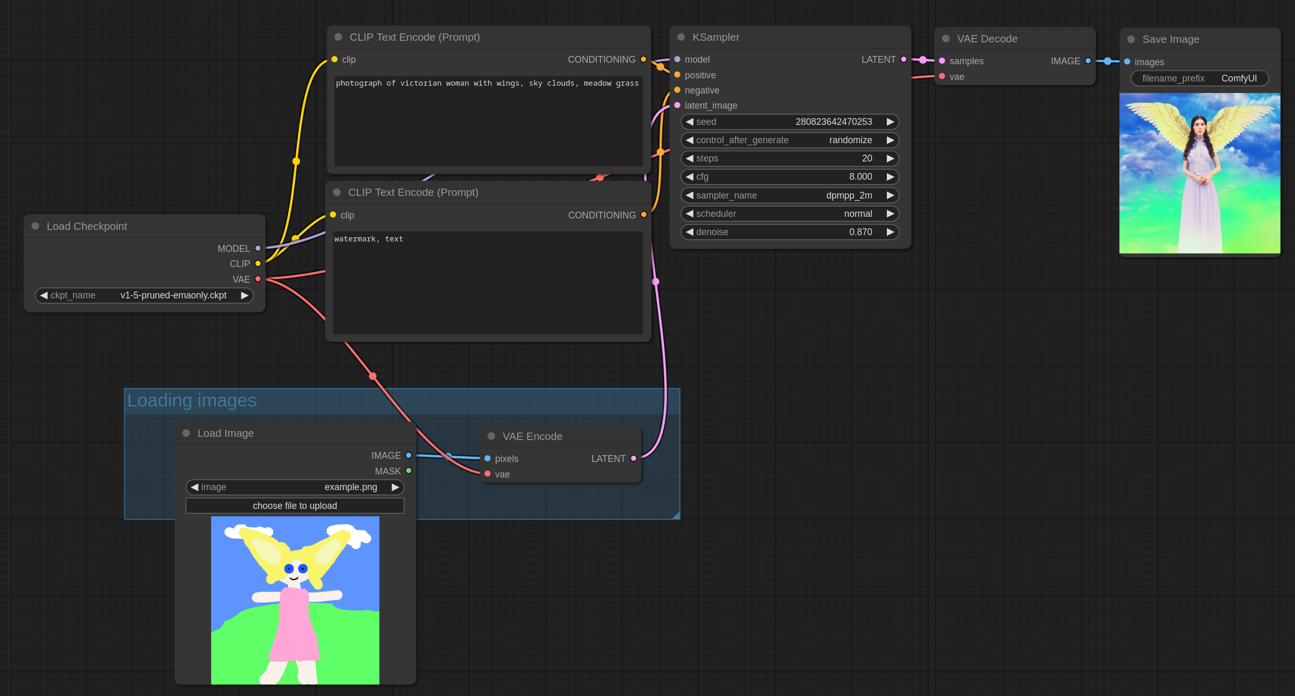
Experiments: ComfyUI
Example (Image to Image)
19

